Slide 1
Digital Maturity Assessment Executive Summary
Digital Strategy
FBNQuest
October 2018

Slide 2
Content
01
Background
02
Key Findings & Initiatives
Notes:
Change colours
Ecosystem scanning
CRM

Slide 3
Background
Notes:
Change colours
Ecosystem scanning
CRM

Slide 4

Background
Context & Objectives
Following the Group’s ambition of becoming the leading Merchant Bank and Asset Manager in Africa, FBNQuest has identified digital as a critical enabler for the realization of this ambition. Consequently, the Group has engaged KPMG, a global leader in digital strategy and transformation services, to provide the assistance required to drive the development of its digital strategy intended to reposition the Group within its target markets.
As part of the Assess phase of Digital Strategy Program, we have run a Digital Maturity Assessment (DMA) to prepare this report on FBNQuest’s current baseline / starting position for Digital.
The objective of the Digital Maturity Assessment is to obtain a diagnosis of how well positioned FBNQuest is to successfully navigate digital transformation journey and identify existing gaps by benchmarking its capabilities against those of its peers and global players in similar lines of business.
Initiate
Program Initiation
Assess
Digital Maturity Assessment
Strategize
Customer Propositions
Operating Model
Value Management
Technology Enablement
Risk Model
Co-creation Model
Plan
Digital
Transformation
Roadmap

Slide 5
Background
Digital Maturity Assessment Approach
The digital maturity assessment (DMA) for FBNQuest Group covered six (6) domains and twenty-one (21) sub-domains, as follows:
Relevant domains and sub-domains were identified for the Digital Maturity Assessment
For each domain and sub-domain, current state assessment and benchmarking were carried out utilising the following sources of information:
Calibrate FBNQuest’s current maturity relative to local & global benchmarks and the aspiration state
1
2
3
Digital Maturity Survey, Interviews
& Current State Documentation Review
Maturity Rating
A
Lagging
Behind the industry
Digital maturity assessment surveys were deployed, current-state documents were reviewed and relevant stakeholders were interviewed across FBNQuest business entities and enabling functions to elicit feedback on the current state with respect to the digital journey.
Basic
Fit for purpose
Progressed
Foundational capability in place to enable progression to leading state
Leading
Aligned to leading industry players
Innovating
Leading the leaders, experimenting with emerging capability
B
Relative Industry Comparison
Based on external insights from research and industry-knowledge, FBNQuest was benchmarked against local peers and global leaders in its line of business. Consequently, the bank’s aspirational state was defined based on input from the benchmarking as well as the inferred target state per the DMA survey.

Slide 6
Background
1
Digital Maturity Assessment Scope
The digital maturity assessment for FBNQuest Group covered six (6) dimensions and twenty (20) sub dimensions of Digital, as follows:
Value Management
Customer Experience Mgt.
Leadership, Ambition & Strategy
Digital KPIs and Value Realisation
Market/Customer Insight
Customer Experience Management
Digital Marketing & Sales
Digital Channels
Risk Model
01
02
Operating Model
Risk Governance
Risk Monitoring
Risk Definition & Risk Ownership
Cyber Security risk
Focus
Areas
Governance Model
Digital Workforce
Process Digitization
06
03
Co-Creation Model
Technology Enablement
05
04
Innovation Strategy
Innovation Sourcing
Partnerships and Collaboration
Application Programming Interfaces (APIs)
Cloud Model
Analytics & Artificial Intelligence
User Experience & User Interface

Slide 7
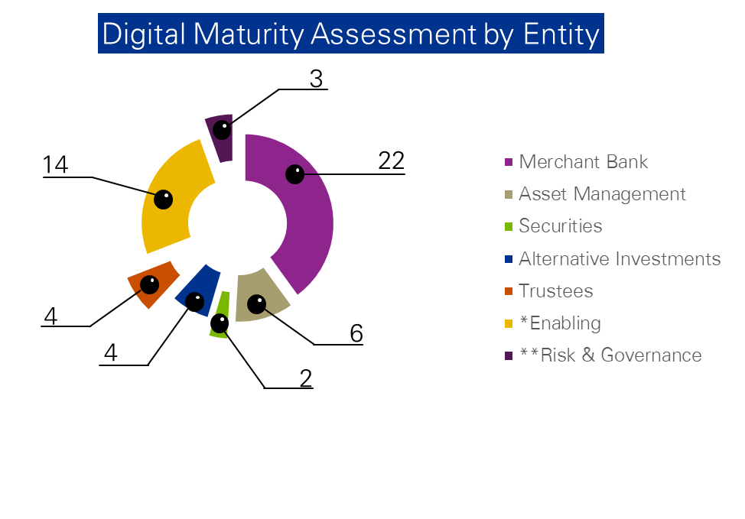
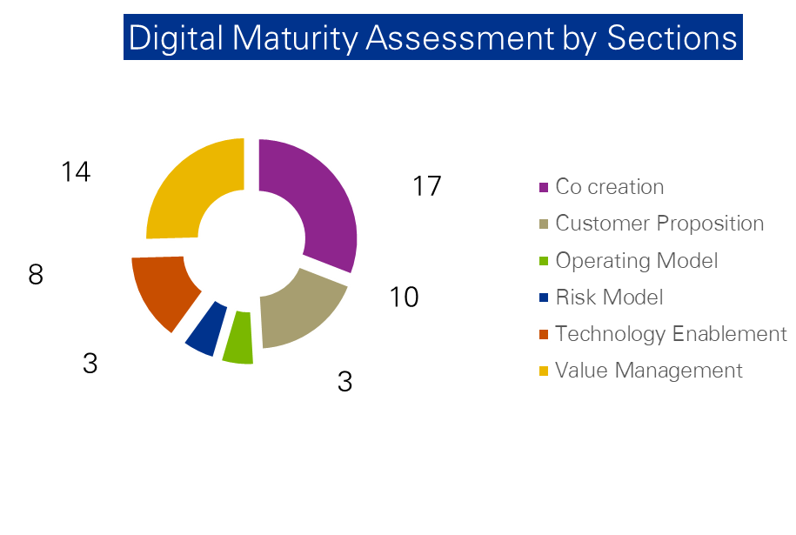
Background
2A
Digital Maturity Assessment (DMA) Survey Coverage
The DMA survey cut across over fifty (50) stakeholders across the FBNQuest’s business entities and enabling functions, as follows:
The above chart shows the participation spread across various business entities for the Digital Maturity Assessment across all work streams in scope of the digital strategy.
The above chart shows the spread of participation firm wide across the various work streams for the Digital Maturity Assessment
*Enabling – Information Technology, Human Resources, Corporate Communication & Marketing, Operations and General Services
**Risk & Governance – Strategy, Risk, Compliance, FINCON, Legal and Audit
Refer to Appendix – DMA Survey Coverage for details

Slide 8


















Background
2B
Peer Group & Global Industry Benchmark
FBNQuest was benchmarked against a wide variety of local peers and global leaders in its lines of business as identified below:

Slide 9
Key Findings & Initiatives
Notes:
Change colours
Ecosystem scanning
CRM

Slide 10


Key Findings & Initiatives
Digital Maturity Assessment Result Summary
Overall Assessment of FBNQuest’s Digital Maturity Level
Key:
Current
Peer Group
Global Industry Benchmark
Aspiration
*Domain
Weighting
Lagging
Basic
Progressed
Leading
Innovating
VALUE
MANAGEMENT
CUSTOMER
EXPERIENCE MGT.
10%*
5
4
3
2
1
0
30%*
Whilst FBNQuest is currently digitally immature, a number of digital initiatives have been identified to support the Group’s ambition to grow the business significantly within the next 3 years.
Historically, FBNQuest has offered personalized customer engagement through Relationship Managers rather than via electronic channels.
The online and mobile platform were found to offer limited transactional or servicing capabilities.
Enabling segments of the business also rely on traditional methods, and will require significant changes to culture and processes to accommodate the digital transformation objectives.
Overall FBNQuest’s digital maturity level was found to be lagging behind both local and global peers in the industry.
RISK
MODEL
OPERATING
MODEL
10%*
10%*
20%*
20%*
CO-CREATION
MODEL
TECHNOLOGY
ENABLEMENT
1
Lagging
2
Basic
3
Progressed
4
Leading
5
Innovating
Refer to Appendix – Detailed weighting & scoring approach for details

Slide 11


Key Findings & Initiatives
Key:
Current
Global Industry Benchmark
Aspiration
Value Management
Peer Group
The following key initiatives have been identified for FBNQuest with respect to Value Management:
Defining the ambition that set the agenda for digital with clearly articulated key performance indicators.
Leadership Support & Executive Alignment | Ensure executive level ownership and accountability for digital strategy setting to better drive enterprise-wide acceptance and secure bold alignment at the top
Digital Initiatives Orchestration | Establish a system that identifies the digital initiatives with the most potential to have enterprise-wide impact
Goal Congruence | Approach digital ambition setting emphasizing coordination at all levels of the corporation – alignment at the top, agility in the middle and mobilization at the front line
Value Measurement | Develop a measurable framework of key performance indicators to monitor and report benefits from digital investments
Lagging
Basic
Progressed
Leading
Innovating
Clarity and consistency of vision & strategy
DBS is the first bank to develop a methodology to measure digital value creation – this is done by delineating customers into two segments – digital and traditional, then, defining measurable KPI for the across digital customers across Customer Growth, Transaction Volumes, Value Creation, Customer Experience, Ecosystem Partnerships & Footprint. Refer to Detailed Assessment – Value Management for details.
Utilisation of digital KPIs for value realisation & monitoring
Notes:
Largely within sales team
Engage with fintechs on some collaboration largely on an adhoc basis

Slide 12

Customer Experience Mgt.
Key Findings & Initiatives
Key:
Current
Global Industry Benchmark
Aspiration
Peer Group
The following key initiatives have been identified for FBNQuest with respect to Customer Experience Mgt.:
The capability to provide an optimal customer experience using digital to promote to, communicate with and service customers.
Digital Channels Adoption | Ensure use of social media channels to drive customer engagement and periodically track adoption of social media as a channel of interaction for customers
Tailored Customer Experience | Leverage data analytics for real-time analysis of customer behaviour and transaction trends and creation of better tailored customer experience and products
Personalised Digital Marketing | Ensure comprehensive use of customer analytics to target and personalise digital marketing activities
Digital Channels Enhancement | Enhance existing digital channels (web and mobile) to delivery competitive self-service functionalities for seamless customer experience across customer touch-points
Lagging
Basic
Progressed
Leading
Innovating
Utilisation of customer insight to drive customer satisfaction
Customer experience feedback and measurement
Increased adoption of ‘mobile first’ and ‘AI first’ i.e. delivery of tailored functionalities/ services to customers via mobile, leveraging AI (artificial intelligence) for predictive behavioural analysis.
Investments in digital content marketing to drive brand awareness.
Refer to Detailed Assessment – Customer Experience Management for details.
Data-driven digital marketing
Use of digital channels
Notes:
Largely within sales team
Engage with fintechs on some collaboration largely on an adhoc basis

Slide 13
Operating Model
Key Findings & Initiatives
Key:
Current
Global Industry Benchmark
Aspiration
Peer Group
The following key initiatives have been identified for FBNQuest with respect to Operating Model:
The extent to which an organisation is structured to deliver value to customers leveraging digital.
Digital Governance Structure | Establish a Centre of Excellence, led by the Chief Digital Officer, to overcome functional silos and ensure organisation-wide accountability for the digital agenda
Digital Workforce | Establish a talent development and acquisition strategy that will equip existing talent with digital skill-sets and acquire new talents (data scientists, software engineers etc.)
Process Digitisation | Leverage Artificial Intelligence and Robotics Process Automation to continually optimise performance
Lagging
Basic
Progressed
Leading
Innovating
Establishment of Robust Digital Governance Model
Digital workforce
Digital is recognised as a ‘standalone’ strategic business unit where a Chief Digital/Innovation Officer drives the digital agenda and reports to the CEO.
Automation, advanced robotics and artificial intelligence are used to improve employee productivity.
Refer to Detailed Assessment – Operating Model for details.
Digitisation of key operational processes
Notes:
Largely within sales team
Engage with fintechs on some collaboration largely on an adhoc basis

Slide 14

Key Findings & Initiatives
Key:
Current
Global Industry Benchmark
Aspiration
Technology Enablement
Peer Group
The following key initiatives have been identified for FBNQuest with respect to Technology Enablement:
The extent to which an organisation monitors its own technology footprint in the digital marketplace and reacts to improve and enhance its digital propositions through the implementation and application of technology enablers.
API Management | Implement an API solution manager to better operate FBNQuest’s integration architecture
API Monetisation | Expose FBNQuest’s strategic products externally via APIs to diversify revenue streams, enable customer growth and support partnerships
Cloud Governance | Establish and execute a cloud governance framework to continuously guide the measurement, monitoring, tracking and prediction of cloud take-up
Data and Analytics Automation | Develop a business intelligence (BI) and analytics strategy and road map to facilitate the execution of intelligent reporting and analysis
User Experience Improvement | Establish and document a framework to guide proactive measurement of user experience and continuous improvement of the process
Lagging
Basic
Progressed
Leading
Innovating
API implementation and management
Scalable cloud hosting models
Global players are adopting robust API and cloud strategies
90% of Goldman Sachs servers (over 200,000) are cloud hosted
DBS and JP Morgan have exposed over 150 live APIs
Hackathons are key to driving API adoption by external developers and Fintechs
Refer to Detailed Assessment – Technology Enablement for details.
Optimal utilisation of data & analytics and artificial intelligence
Application of best practice user experience standards
Notes:
Largely within sales team
Engage with fintechs on some collaboration largely on an adhoc basis

Slide 15
Key Findings & Initiatives
Key:
Current
Global Industry Benchmark
Aspiration
Co-creation Model
Peer Group
The following key initiatives have been identified for FBNQuest with respect to Co-creation Model:
The extent to which an organisation monitors its own technology footprint in the digital marketplace and reacts to improve and enhance its digital propositions through the implementation and application of technology enablers.
Innovation Strategy | Develop an innovation strategy that is aligned with the business strategy, and clearly communicated to all FBNQuest staff. This should define the strategy for internal and external innovation sourcing
Innovation Sourcing Platform | Develop a platform to streamline and reward generation of innovative initiatives by FBNQuest staff
Partnership Assessment Metrics | Establish and measure performance metrics to ensure that alliances and partnerships regularly add value to FBNQuest
Lagging
Basic
Progressed
Leading
Innovating
Establishment of Innovation Strategy
Mature internal innovation sourcing processes and platforms
Goldman Sachs has launched an in-house incubator, dubbed GS Accelerate, aimed at encouraging employees to develop new innovative solutions.
Citi is expanding the network of its Global Innovation Labs with the opening of a new hub in London.
Refer to Detailed Assessment – Co-creation Model for details.
Measured and value-driven digital partnerships & collaborations
Notes:
Largely within sales team
Engage with fintechs on some collaboration largely on an adhoc basis

Slide 16
Key Findings & Initiatives
Key:
Current
Global Industry Benchmark
Aspiration
Risk Model
Peer Group
The following key initiatives have been identified for FBNQuest with respect to Risk Model:
The extent to which an organisation monitors the inherent risks in its operating environment and the risks that it will be exposed to upon the commencement of the digital journey
Digital Risk Strategy and Framework | Develop a robust digital risk strategy and framework for adequate management and mitigation of digital risks
Cybersecurity Governance | Adequate staffing of cybersecurity function to ensure security activities are carried out by personnel within the dedicated function
Cybersecurity Strategy and Framework | Develop a cybersecurity strategy with initiatives that align with business and IT strategy. Develop a framework to guide implementation of cybersecurity initiatives
Vulnerability Management | Perform periodic credentialed scan of IT assets (operating system, web applications, network devices and databases) to ensure completeness of scan scope
Security Monitoring | Implement adequate monitoring of IT infrastructure for prompt identification and resolution of security events
Lagging
Basic
Progressed
Leading
Innovating
Risk Governance
Risk Monitoring
Risk is managed through a framework designed to balance strong corporate oversight with well-defined independent risk management. This framework includes the definition of cybersecurity risks.
Citi have pledged to partner with key financial service players and government agencies to establish a unified response to cybersecurity threats.
Refer to Detailed Assessment – Risk Model for details.
Risk Definition & Ownership
Cybersecurity
Notes:
Largely within sales team
Engage with fintechs on some collaboration largely on an adhoc basis

